Slide 1
Lesson Eight: Solve Linear Equations using Cramer’s Rule
mgichuki@jkuat.ac.ke

Slide 2
Cramer’s Rule Definition
Cramer’s rule is one of the important methods applied to solve a system of equations.
In this method, the values of the variables in the system are calculated using the determinants of matrices.
Thus, Cramer’s rule is also known as the determinant method.

Slide 3
In linear algebra, Cramer’s rule is a specific formula used for solving a system of linear equations containing as many equations as unknowns, efficient whenever the system of equations has a unique solution.
The rule is named after Gabriel Cramer (1704–1752), the rule publisher (1750)
It is the most commonly used formula for getting the solution for the given system of equations formed through matrices.
The solution obtained using Cramer’s rule will be in terms of the determinants of the coefficient matrix and matrices obtained from it by replacing one column with the column vector of the right-hand sides of the equations.

Slide 4
Cramer’s Rule Formula
Consider a system of linear equations with n variables x₁, x₂, x₃, …, xₙ written in the matrix form AX = B.
Here,
A = Coefficient matrix (must be a square matrix)
X = Column matrix with variables
B = Column matrix with the constants (which are on the right side of the equations)
Now, we have to find the determinants as:
D = |A|, Dx₁, Dx₂, Dx₃,…, Dx_{n}
Here, Dx_{i} for i = 1, 2, 3,…, n is the same determinant as D such that the column is replaced with B. meaning,
x₁ = Dx₁/D; x₂ = Dx₂/D; x₃ = Dx₃/D; ….; x_{n} = Dx_{n}/D {where D is not equal to 0}

Slide 5
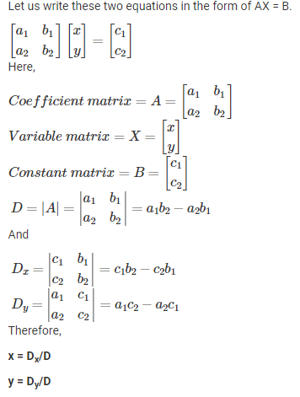
Cramer’s Rule for a 2×2 Matrix
Cramer’s rule for the 2×2 matrix is applied to solve the system of equations in two variables.
Let us consider two linear equations in two variables.
a₁x + b₁y = c₁
a₂x + b₂y = c₂

Slide 6
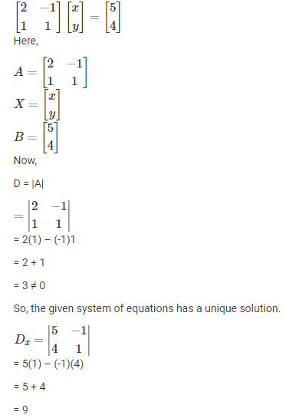
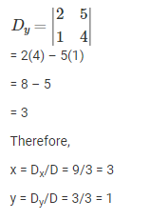
Question: Solve the following system of equations using Cramer’s rule:
2x – y = 5
x + y = 4
Solution:
We write these equations in the form AX = B.

Slide 7
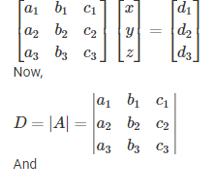
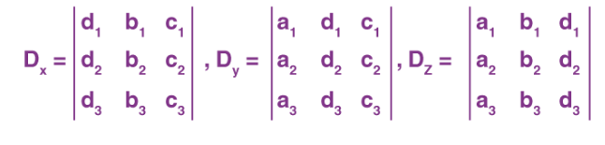
Cramer’s Rule for a 3×3 Matrix
To find the Cramer’s rule formula for a 3×3 matrix, we consider the system of three equations with three variables.
Consider:
a₁x + b₁y + c₁z = d₁
a₂x + b₂y + c₂z = d₂
a₃x + b₃y + c₃z = d₃
We write these equations in the form AX = B.
Therefore, x = D_{x}/D, y = D_{y}/D, z = D_{z}/D; D ≠ 0

Slide 8
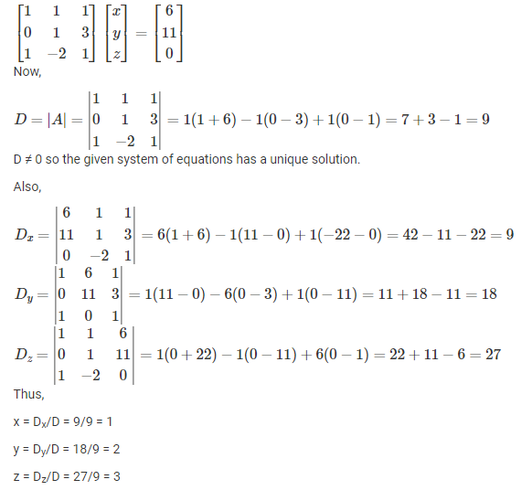
Cramer’s Rule Example for a 3×3 Matrix
Question: Solve the following system of equations using Cramer’s rule:
x + y + z =6
y + 3z = 11
x + z =2y or x – 2y + z = 0
Solution:
We write these equations in the form AX = B.

Slide 9
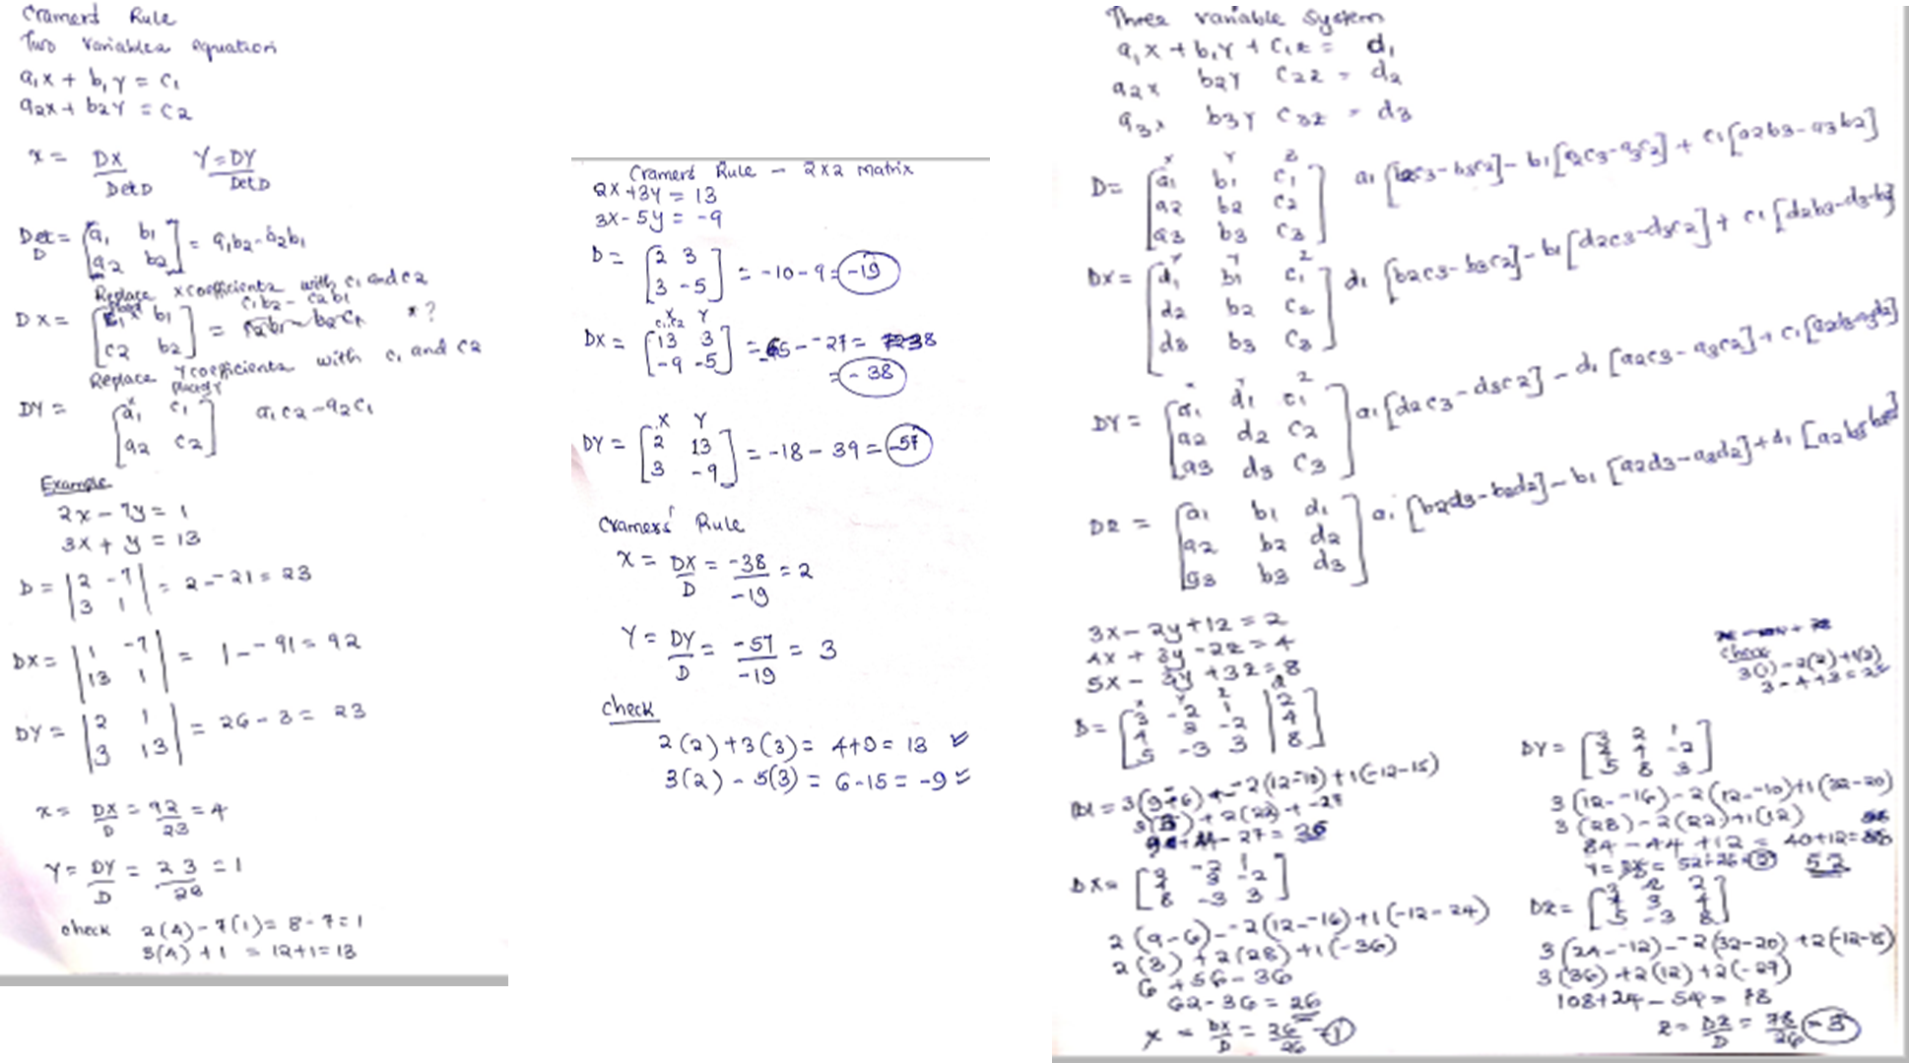
Cramer's Rule

Slide 10
Questions? Comments?

